Slide 1



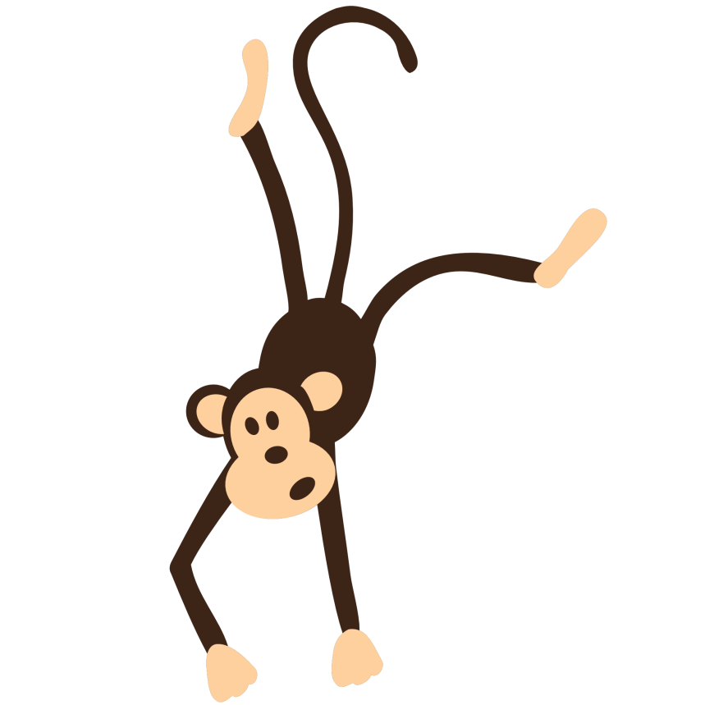
Интерактивный тренажер «Артикли»

Slide 2
-
a
the
I have got … mother.

Slide 3
-
a
the
I like … chocolate.

Slide 4
-
a
the
Does he listen to … jazz music?

Slide 5
-
a
the
… bus over there is moving too fast.

Slide 6
-
a
the
… weather is nasty today.

Slide 7
-
a
the
People can’t live on … moon.

Slide 8
-
a
the
My teacher’s name is … Robert.

Slide 9
-
a
the
This is … second day of our trip.

Slide 10
-
a
the
… carrots are good for eyes.

Slide 11
-
a
the
Diana has … sore throat.

Slide 12
-
a
the
David can play … guitar.

Slide 13
-
a
the
I really enjoyed … book you give me.

Slide 14
-
a
the
I really enjoyed … book you give me.

Slide 15
-
a
the
My son is … schoolboy.

